Slide 1


Analyzing 1 Billion+ NYC Yellow Taxi and Uber Rides for Taxi Drivers
Jialei Zheng
Ruilin Zhong
Shengjia Zhang

Slide 2
Project Overview
Uber v.s. Yellow Taxi in Manhattan?
Analyze and compare relationship between ride amount of yellow taxi and Uber, at different locations and time
2. Predict demands for Yellow Taxi in specified area at specific time
Given pickup location, time, weather condition, etc., apply machine learning algorithms to predict:
Ride amount requested by passengers
Average fare amount
Average tip amount
3. Develop a web app to inform Yellow Taxi drivers of real-time predicted ride amount, distance, and tip, so that riders could make better pick-up decisions

Slide 3
Business Value and Social Value
Helps NYC yellow taxi drivers - underprivileged population
Modeled on “Big Data” (with 20G + size, ~ 24 million data-points), can potentially scale up to predict Uber’s ride requests, distance & fare amount., and other parameters of interest
Can scale up to other cities out of NYC
$$$HUGE BUSINESS VALUE$$$ for Drivers, Passengers, Car-sharing companies, and governments!

Slide 4
Data Source
The TLC Yellow Taxi dataset
Pickup & drop-off locations, trip time & date, fare, tips
10+ million rides per month
From Jul 2015 to Jun 2016 and Apr 2014 to Sep 2014
Uber trip data
Date/time, pickup coordinates
Incomplete: Apr 2014 to Sep 2014
Historical weather data for each day
Fetched from http://weathersource.com/
Collect each day’s weather data into a dictionary

Slide 5
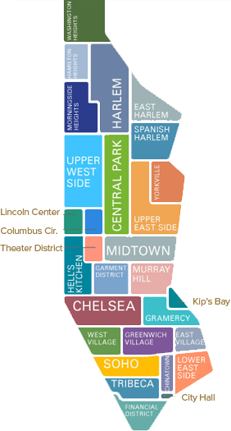
Data Processing
Location: from coordinate (latitude, longitude) ---> neighborhood e.g. (40.762344, -73.982364) ---> Midtown
Using Ray-casting algorithm that finds out if a given point lies within a predetermined area defined by a 2-D polygon
Pickup time: divided into hours.
Weather: collect historical weather data for each day.
Business day or not
Temperature in Fahrenheit
For each unique combination of: (neighborhood, hour, is_business_day, weather, temperature) Count the DAILY total rides, average fare and tips.

Slide 6
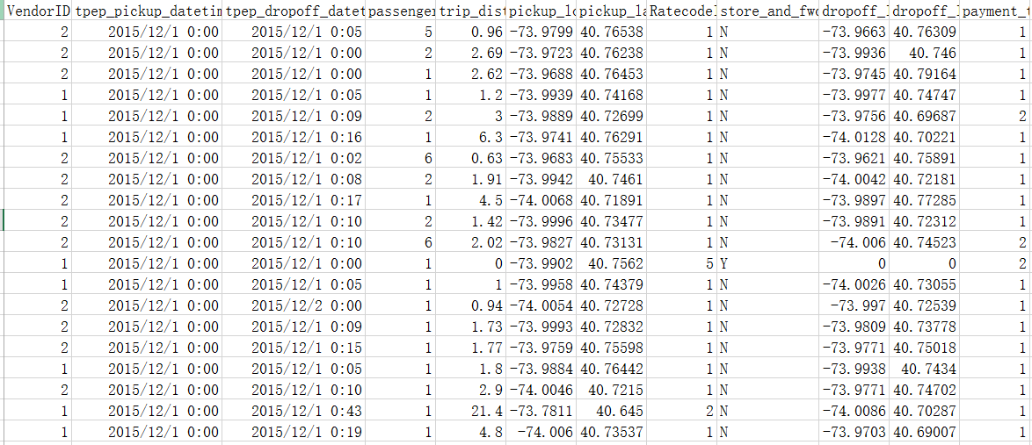
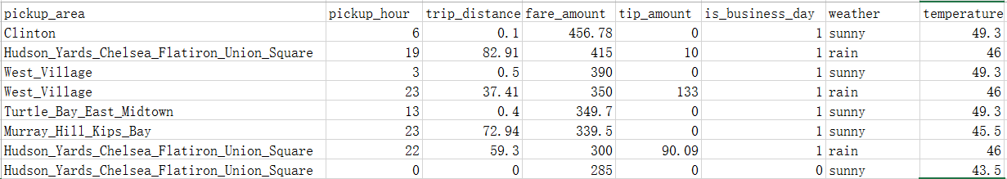
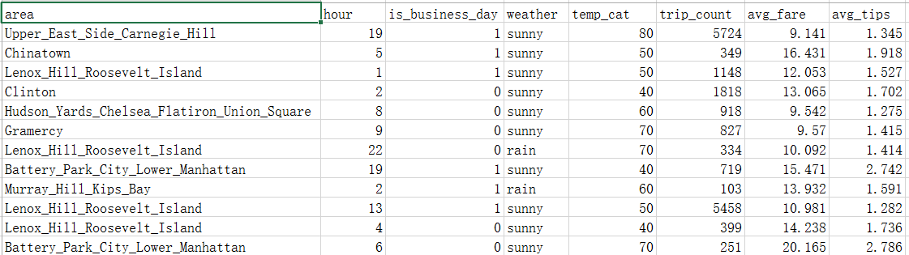
Data Processing

Slide 7
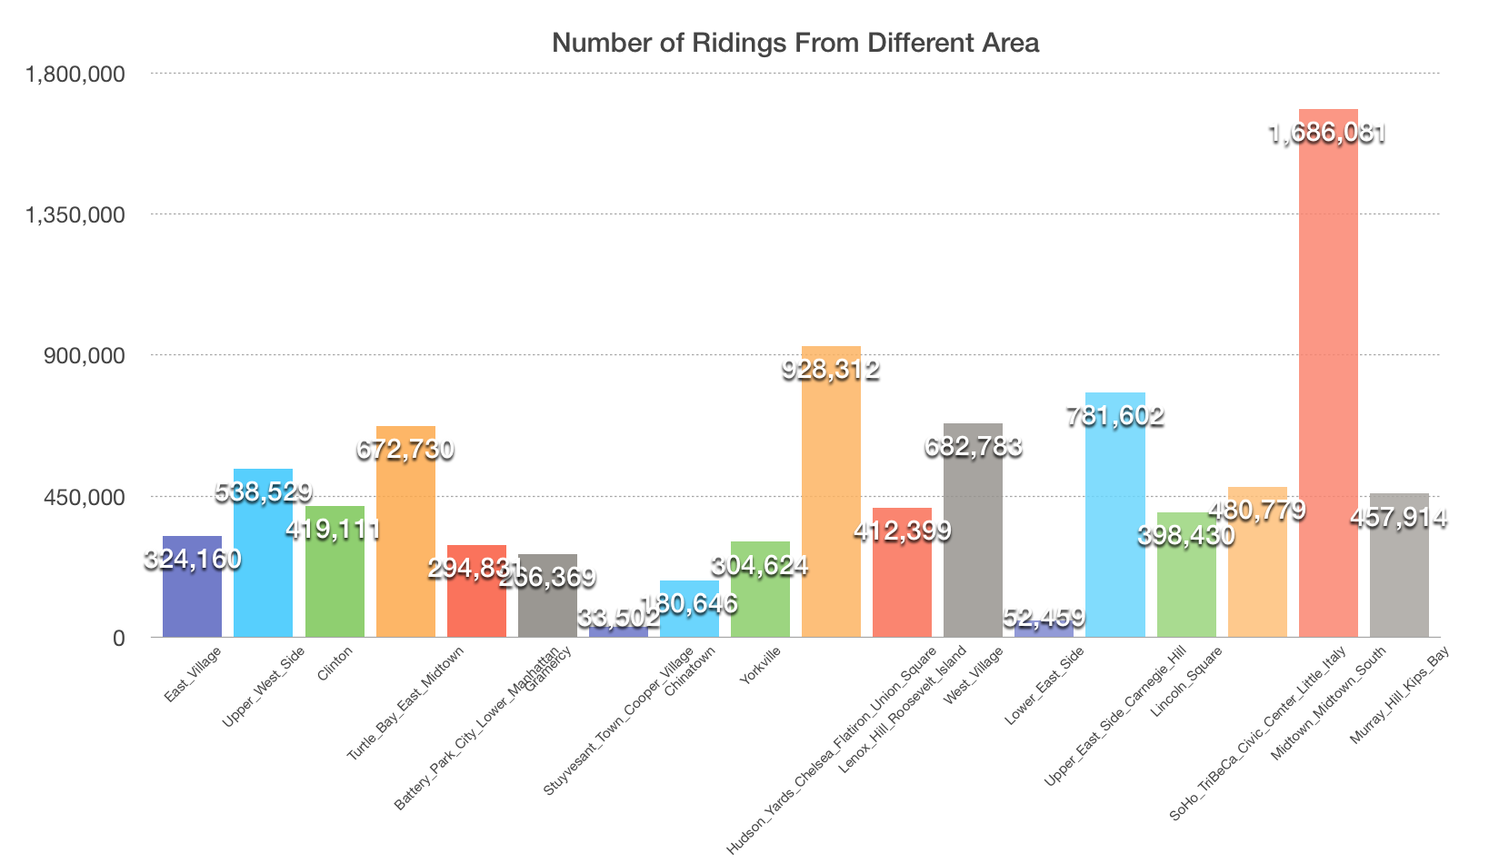
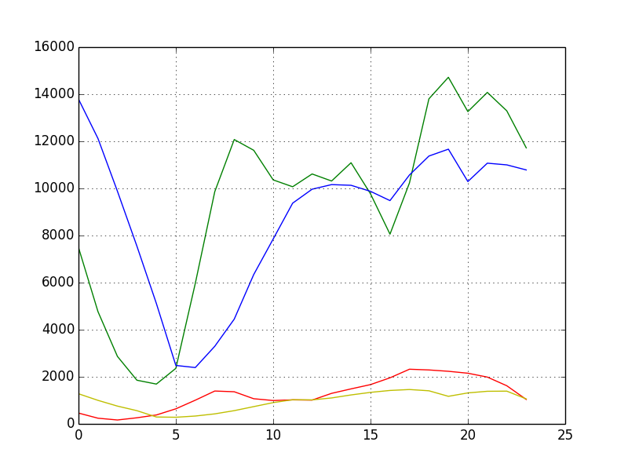
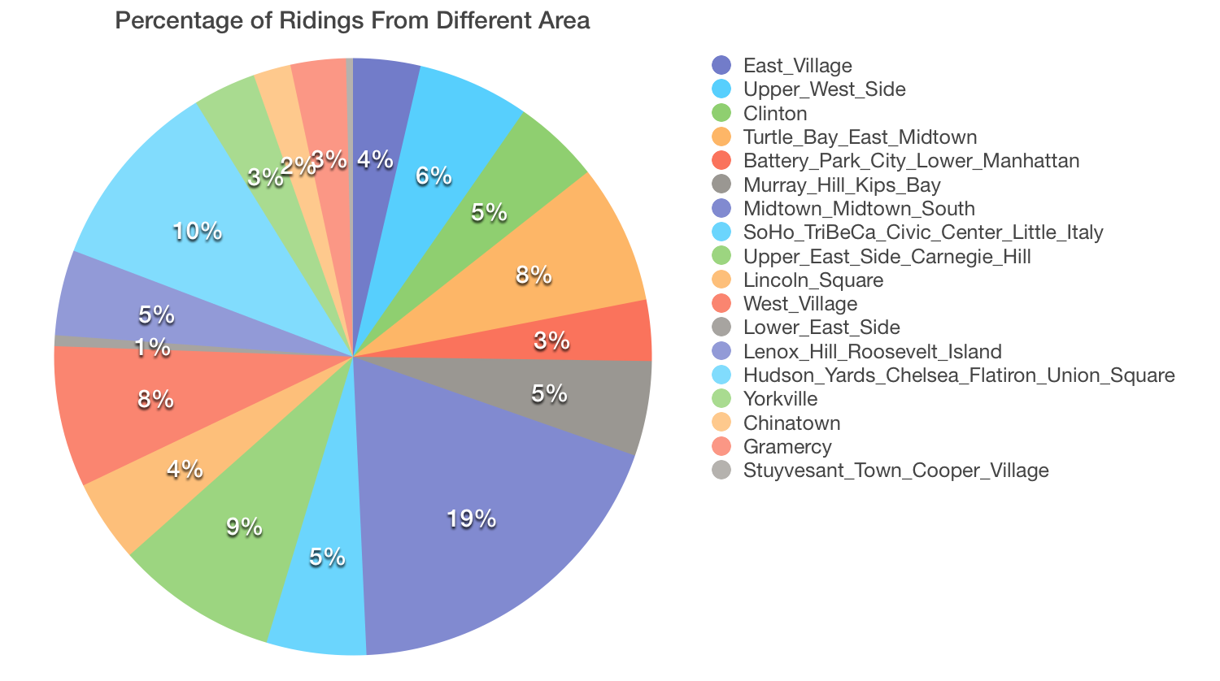
Visualization:
Exploratory Data Analysis
Riding Numbers In a Day
Weekday Taxi
Weekend Taxi
Weekday Uber
Weekend Uber

Slide 8
ML Algorithms: Features and outcome variables
Objectives: predict 3 continuous outcome variables
Total number pickup rides (pickup_counts)
Expected (average) trip fare (after-tax but before-tip)
Expected (average) tip fare
Based on 3 categorical and 2 continuous (numerical) features:
Neighborhood of pickup location (categorical; 18 neighborhoods in Manhattan below West 110th Street and East 95th Street)
Pickup time (numerical; grouped hourly into 24 categories)
Weather (categorical; 3 categories: sunny, rain, or snow)
Business day or weekend/federal holiday (categorical; binary)
Temperature in Fahrenheit (numerical; with 10F interval i.e. 10, 20, …, 90)

Slide 9
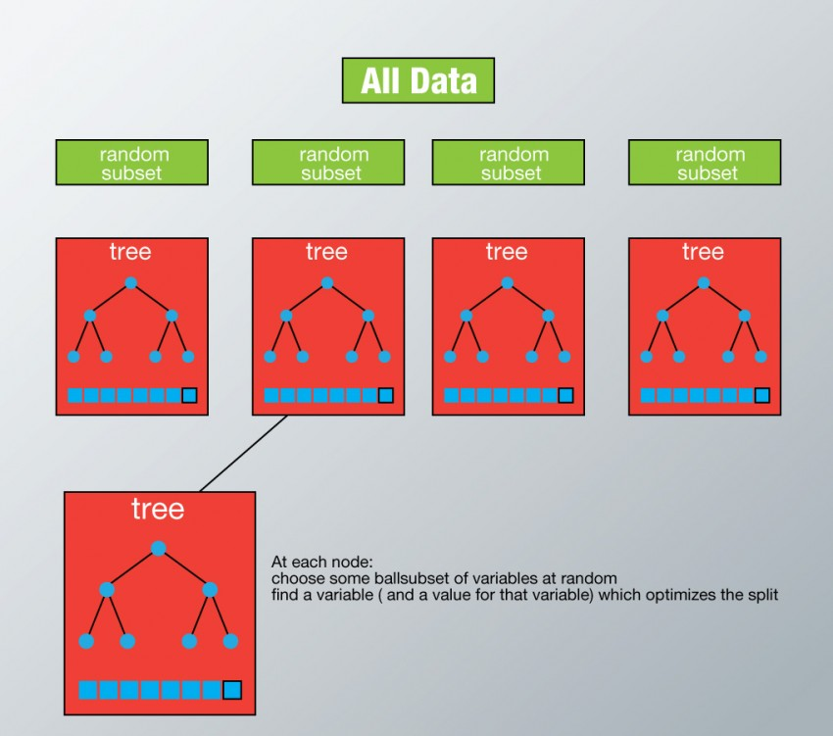
ML Algorithms: Random Forest
Given several categorical features , we use Random Forest, a “panacea” for data scientists!
Algorithm Pros:
Can handle both categorical & numerical features
Can rank importance of features
Non-parametric → no assumptions on raw data
Remains accuracy when a lot of data missing
Well-handles unbalanced data & non-linearity
As a decision-tree algorithm, easy to interpret

Slide 10

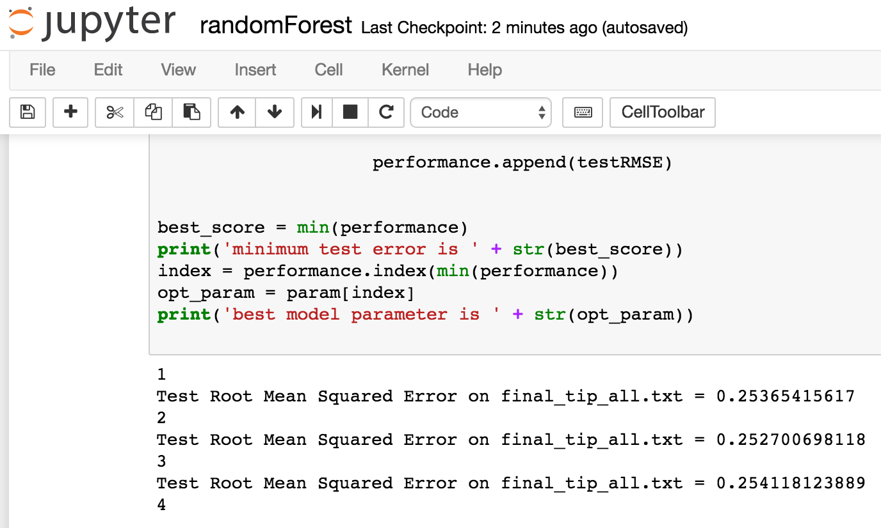
Implementing & Tuning RF in PySpark
PySpark MLlib → implement Random Forest regression in MapReduce
Tune model parameters (number of trees, max tree depth, split strategy, etc.) with extensive experiments on year-long dataset (2015Jul - 2016Jun) on Jupyter Notebook

Slide 11
Model Test Performance
Metrics:
Root-mean-square deviation (RMSD) on test data (20% randomly sampled)
Best Model so far:
500 trees, 10 as max tree depth, 64 as maximum number of bins
 | Average Fare | Average Tip | Pickup Count
RMSE on test | $1.26 | $0.25 | 630

Slide 12

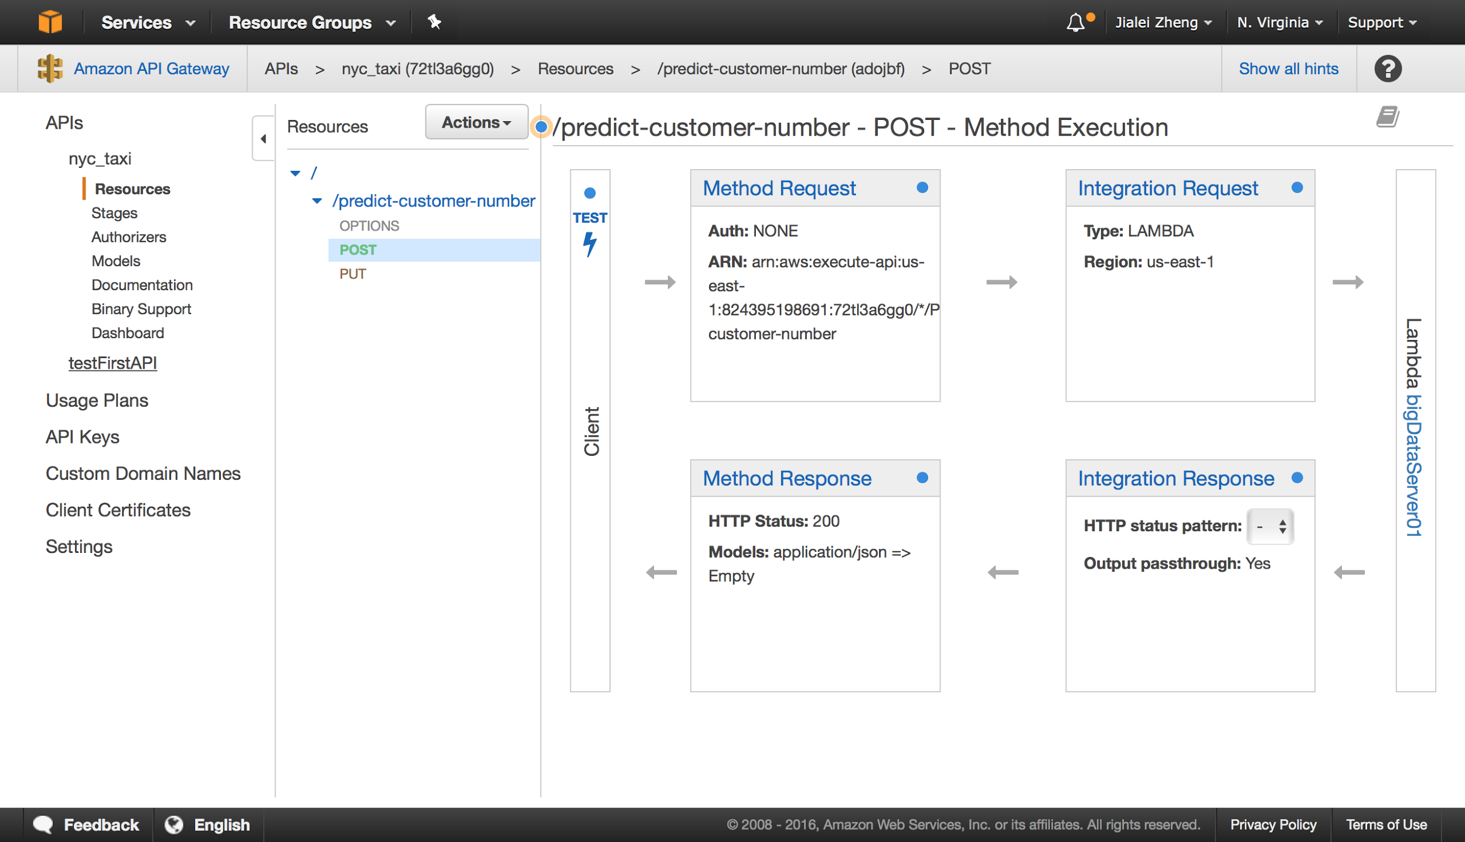
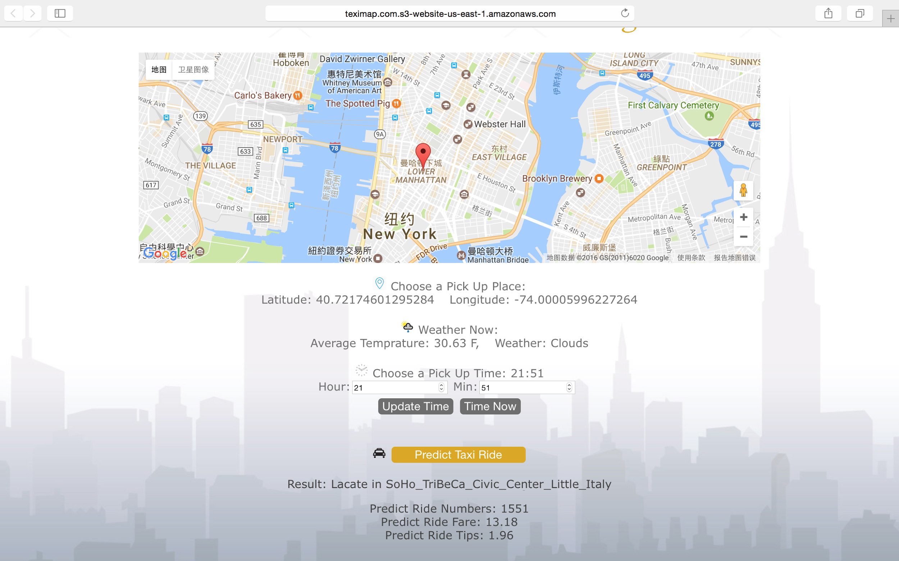
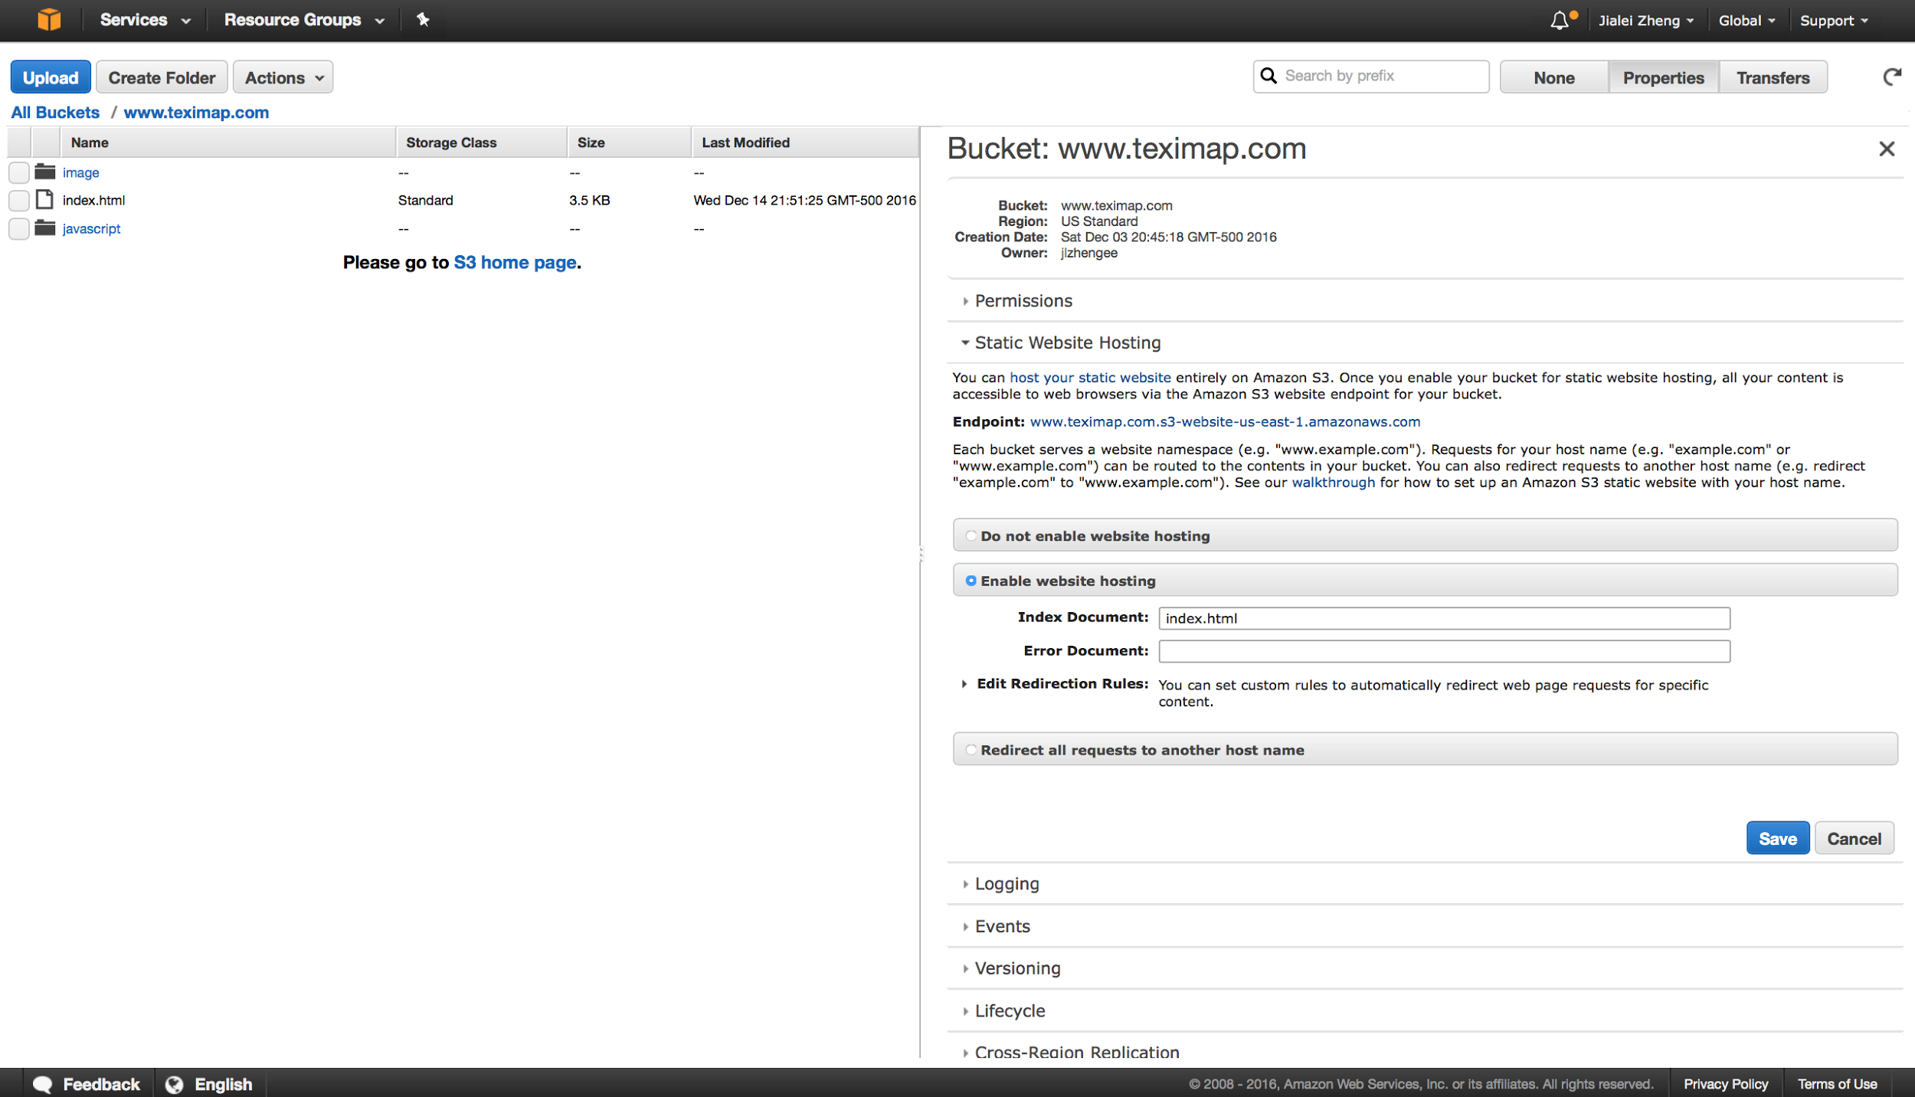
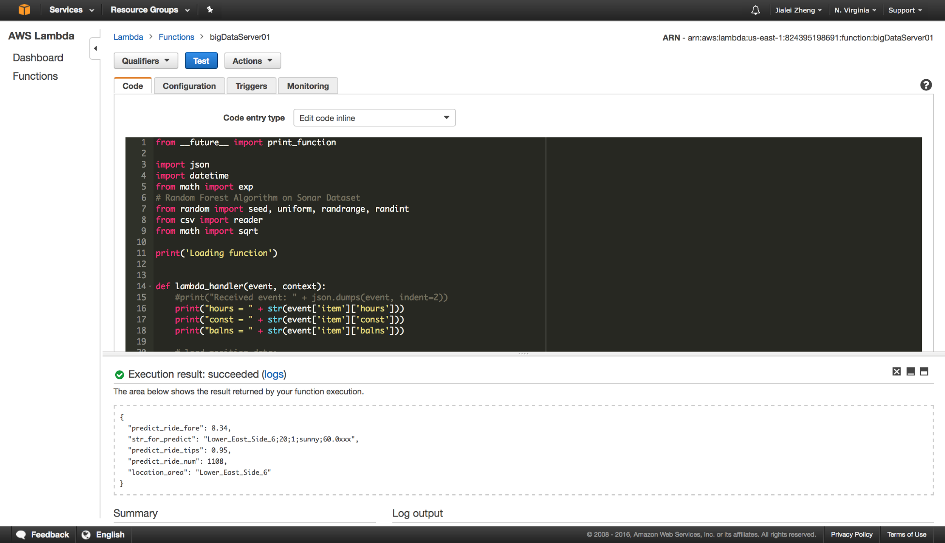
Web Application
Use AWS S3, API Gateway and AWS Lambda Function to build a Web App.
URL Mapping
Front End
Back End
http://www.teximap.com.s3-website-us-east-1.amazonaws.com/

Slide 13
Thank You! Q&A

